Slide 1
CHAPTER – 4 PRINCIPLES AND PROCESSES OF BIOTECHNOLOGY

Slide 2
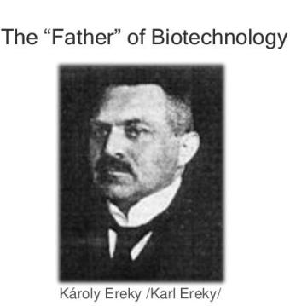
INTRODUCTION
Biotechnology is the science of applied biological process.
science of development and utilization of biological processes, forms and systems for the benefit of mankind and other life forms.
Th e term biotechnology was coined by Karl Ereky, a Hungarian Engineer in 1919.

Slide 3
Traditional vs modern biotechnology
TRADITIONAL BIOTECHNOLOGY
MODERN BIOTECHNOLOGY
This kitchen technology uses bacteria and other microbes in the daily usage for preparation of dairy products like curd, ghee, cheese and in preparation of foods like idli, dosa, nan, bread and pizza. And preparation of alcoholic beverages like beer, wine, etc.
This relies on two aspects :
ability to change the genetic material for getting new products with specific requirement through recombinant DNA technology
ownership of the newly developed technology and its social impact.

Slide 5
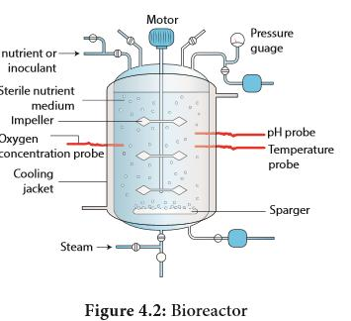
Traditional biotechnology
Fermentation
Fermentation refers to the metabolic process in which organic molecules (normally glucose) are converted into acids, gases, or alcohol in the absence of oxygen or any electron transport chain.
The study of fermentation, its practical uses is called zymology and
It originated in 1856, when French chemist Louis Pasteur demonstrated that fermentation was caused by yeast.

Slide 6
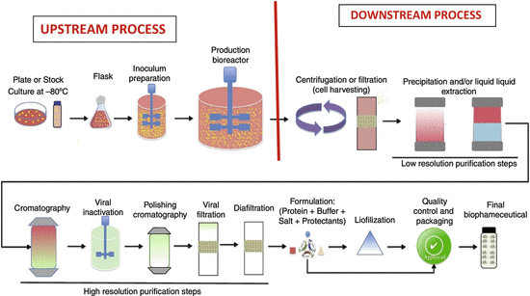
FERMENTATION
UPSTREAM PROCESS
DOWN STREAM PROCESS
All the process before starting of the fermenter such as sterilization of the fermenter, preparation and sterilization of culture medium and growth of the suitable inoculum are called upstream process.
All the process after the fermentation process is known as the downstream process. This process includes distillation, centrifuging, filtration and solvent extraction.

Slide 7
APPLICATIONS OF FERMENTATION PROCESS
Microbial biomass : Microbial cells (biomass) like algae, bacteria, yeast, fungi are grown, dried and used as source of a complete protein
Microbial metabolites : Primary and secondary
Enzymology : When microbes are cultured, they secrete some enzymes into the growth media. These enzymes are industrially used in detergents, food processing, brewing and pharmaceuticals. Eg. protease, amylase, isomerase, and lipase.
Bioconversion or Biotransformation : The fermenting microbes has the capacity to produce valuable products, eg. conversion of ethanol to acetic acid (vinegar),
Single Cell Protein (SCP) : protein supplement

Slide 8
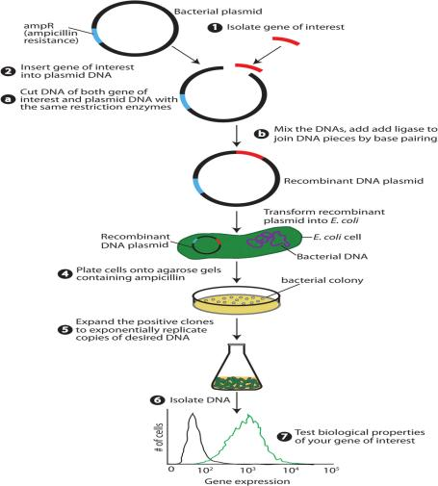
MODERN BIOTECHNOLOGY
The modern biotechnology embraces all the genetic manipulations, protoplasmic fusion techniques and the improvements made in the old biotechnological processes.
Basic steps involved in genetic engineering (fig)

Slide 9
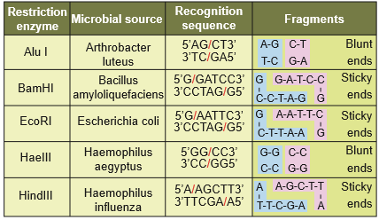
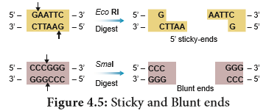
TOOLS FOR GENETIC ENGINEERING
RESTRICTION ENZYMES
TYPES OF RESTRICTION ENZYMES
STICKY AND BLUNT ENDS
are a part of defense mechanism in some microbes
Restriction modification system
NOMENCLATURE
EcoRI
E – genus – Escherichia
co – species – coli
R – strain
I – order of discovery
Linkers or Adaptors are used to stick blunt end cutters to stick themselves to the vectors

Slide 10
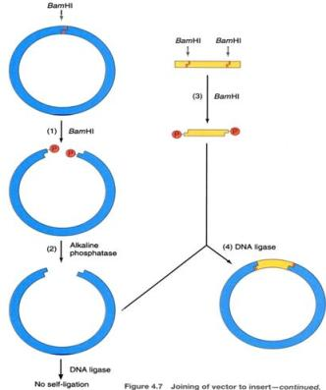
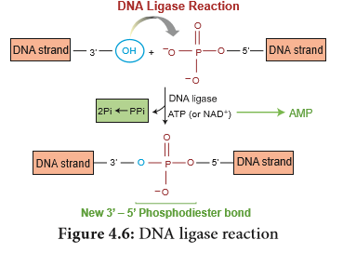
OTHER ENZYMES FOR RECOMBINANT DNA TECHNOLOGY
DNA LIGASE & ALKALINE PHOSPHATASE

Slide 11
Vectors : properties
Ori site
Selectable marker
Multiple cloning site
Relatively small

Slide 12
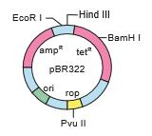
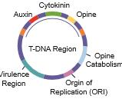
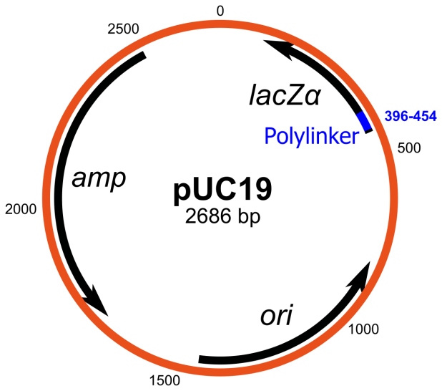
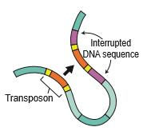
VECTORS : TYPES
pBR 322
Ti plasmid
pUC 19
Transposons
P stands for plasmid
B – Boliver
R – Rodriguez
322 – number to segregate from other plasmids
Ti – Tumor inducing
It is the natural genetic engineer of plants
UC – university of California
19 - number to segregate from other plasmids

Slide 13
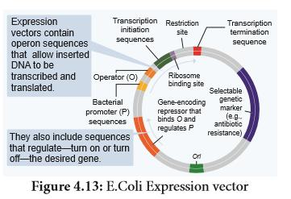
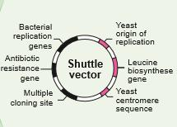
Other vectors
Can replicate both in prokaryotic & eukaryotic cell
Can control gene expression in cells

Slide 14
COMPETENT HOST
E.coli : optimal growing conditions the cells divide every 20 minutes.
For the expression of eukaryotic proteins, eukaryotic cells are preferred because to produce a functionally active protein it should fold properly and post translational modifications should also occur, which is not possible by prokaryotic cell (E.coli).

Slide 15
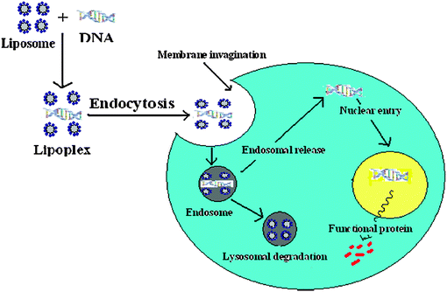
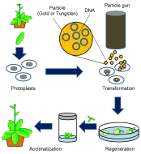
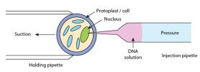
Methods of gene transfer
DIRECT OR VECTORLESS GENE TRANSFER
CHEMICAL MEDIATED
LIPOSOME MEDIATED
PEG
DEXTRAN
ELECTROPORATION
BIOLISTICS
MICROINJECTION

Slide 16
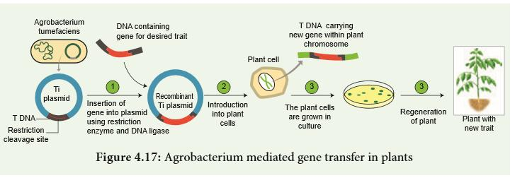
Indirect or vector mediated gene transfer
Ti plasmid mediated gene transfer

Slide 17
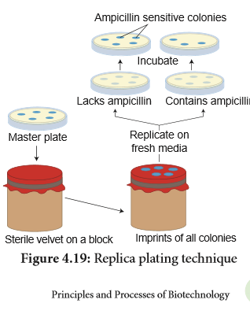
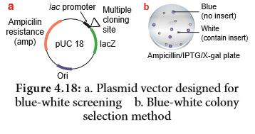
Screening of recombinants
INSERTIONAL INACTIVATION
REPLICA PLATING
blue white selection & antibiotic resistant marker

Slide 18
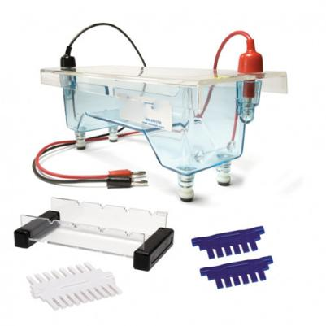
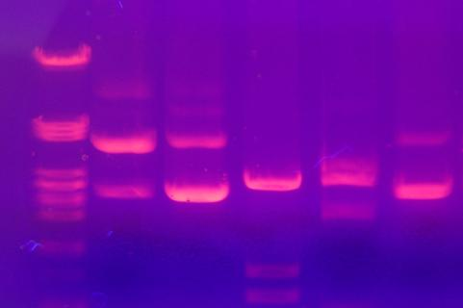
AGAROSE GEL ELECTROPHORESIS
Agarose gel electrophoresis apparatus
DNA bands on Gel under UV

Slide 19
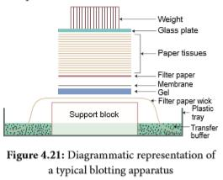
Southern BLOTTING

Slide 20
TYPES OF BLOTTING TECHNIQUES

Slide 21
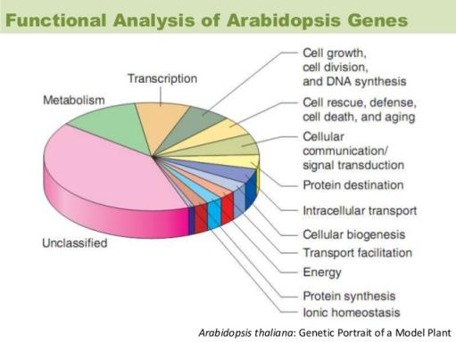
GENOME SEQUENCING AND PLANT GENOME PROJECT
Genome project refer to a project in which the whole genome of plant is analysed using sequence analysis and sequence homology with other plants.
Such genome projects have so far been undertaken in Chlamydomonas(algae), Arabidopsis thaliana, rice and maize plants.

Slide 22
GENOME EDITING
CRISPR CAS 9
RNA INTERFERENCE
ability to change an organism’s DNA.
This technology allows genetic material to be added, removed, or altered at particular locations in the genome.

Slide 23
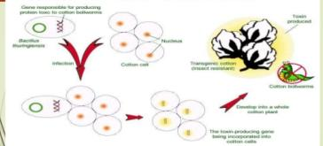
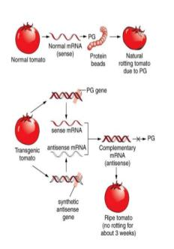
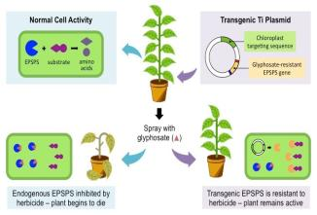
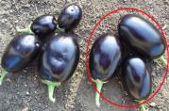
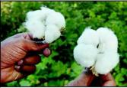
TRANSGENIC CROPS
HERBICIDE TOLERANCE
INSECT RESISTANCE
FLAVR SAVR TOMATO
Bt Brinjal
Bt Cotton

Slide 24
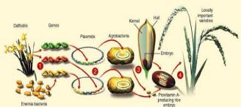
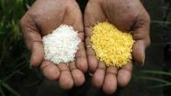
TRANSGENIC CROPS
NUTRIENT QUALITY IMPROVEMENT
PHB
PHB is produced by some microbes such as Bacillus megaterium in response to physiological stress mainly under nutrient derived condition.
PHB derived plastics are attractive as they are compostable and are biodegradable.
Golden Rice

Slide 25
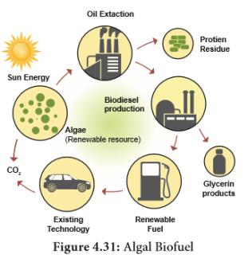
BIOPHARMING
BIOFUEL
It is defined as the use of microorganisms or plants to clean up environmental pollution.
Algal fuel, also known as algal biofuel, or algal oil is an alternative to liquid fossil fuels, the petroleum products.
This use algae as a source of energy-rich oils. Also, algal fuels are an alternative to commonly known biofuel sources obtained from corn and sugarcane.

Slide 26
BIOPROSPECTING
BIOPIRACY
Bioprospecting is the process of discovery and commercialization of new products obtained from biological resources.
Bioprospecting may involve biopiracy, in which indigenous knowledge of nature, originating with indigenous people, is used by others for profit, without authorization or compensation to the indigenous people themselves.
Biopiracy can be defined as the manipulation of intellectual property rights laws by corporations to gain exclusive control over national genetic resources, without giving adequate recognition or remuneration to the original possessors of those resources.
Examples of biopiracy include recent patents granted by the U.S. Patent and Trademarks Office to American companies on turmeric, ‘neem’ and, most notably, ‘basmati’ rice. All three products are indigenous to the Indo-Pak subcontinent.

Slide 27
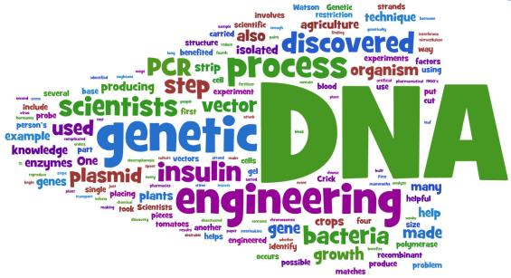
Thank you

